Slide 1

Tuple and Domain Relational Calculus
Database Management System | Relational Model and Formal Query Languages
Course: Database Management System | Chapter: Relational Model and Formal Query Languages | Program: Bachelor of Engineering
DISCOVER · LEARN · EMPOWER
Notes:
Welcome everyone to today's advanced session on formal query languages. We are diving deep into the mathematical foundations of how we ask questions of a database. Specifically, we will explore Tuple and Domain Relational Calculus as non-procedural alternatives to Relational Algebra. Remember, these languages define what data to retrieve, not how to retrieve it.

Slide 2
Course Outcomes
SLIDE 2 / 14
Course Outcome
CO | BT LEVEL | DESCRIPTION
CO1 | BT2 | Explain database architecture, relational model concepts and formal query language foundations including relational algebra and relational calculus.
CO2 | BT3 | Apply relational algebra, relational calculus and SQL constructs to formulate correct and efficient database queries.
CO3 | BT4 | Analyze functional dependencies and design normalized relational schemas up to 5NF ensuring lossless join and dependency preservation.
CO4 | BT4 | Analyze transaction schedules and concurrency control mechanisms to determine serializability, recoverability and correctness.
CO5 | BT5 | Evaluate storage structures, indexing strategies and query optimization techniques for performance, scalability and reliability.
Chandigarh University
2 / 14
Notes:
Today's lecture directly addresses CO1 by explaining the foundations of formal query languages. We will also touch upon CO5 because understanding the logical structure of these queries is essential for optimizing how the database engine executes them. Mastering these calculus forms allows us to evaluate query performance and scalability effectively.

Slide 3
Learning Objectives
SLIDE 3 / 14
Learning Outcomes
1
Analyze the fundamental syntax and logical structure of Tuple Relational Calculus.
2
Differentiate between Tuple and Domain Relational Calculus based on variable binding.
3
Evaluate the safety conditions required to prevent infinite result sets in calculus.
4
Construct valid calculus expressions to solve complex database retrieval problems.
5
Compare the expressive power of calculus against Relational Algebra operations.
Chandigarh University
3 / 14
Notes:
By the end of this session, you will be able to analyze the syntax of these calculus forms. You will differentiate between the two types based on how variables bind to tuples versus attributes. We will also evaluate safety conditions, as this is a critical concept for preventing infinite loops in query results.

Slide 4
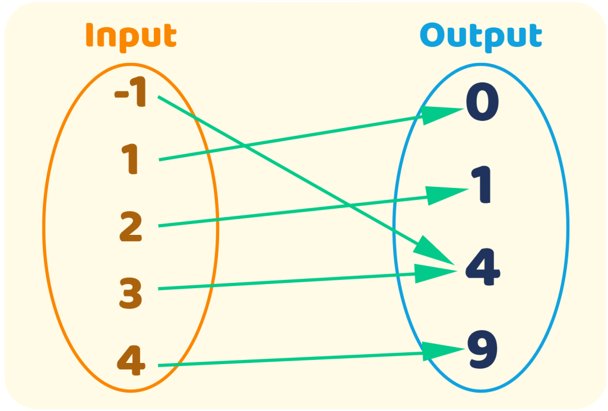
Lecture
SLIDE 4 / 14
Tuple Relational Calculus Definition
1
TRC uses variables that range over entire tuples from a specific relation.
2
A query is expressed as {t | P(t)} where t is a tuple variable.
3
P(t) is a formula that evaluates to true for tuples satisfying the condition.
4
The result is a set of tuples that make the formula P(t) true.
5
Variables in TRC represent rows, not individual column values within rows.
6
This approach is non-procedural as it specifies what to retrieve, not how.
What Is a Function? Representing with Tables, Graphs, and Mappings - Math Learning | Think Academy US
Chandigarh University
4 / 14
Notes:
Tuple Relational Calculus uses variables that range over entire tuples from a specific relation. A query is expressed as {t | P(t)} where t is a tuple variable and P(t) is a formula. The result is a set of tuples that make the formula true. This approach is non-procedural as it specifies what to retrieve, not how.

Slide 5
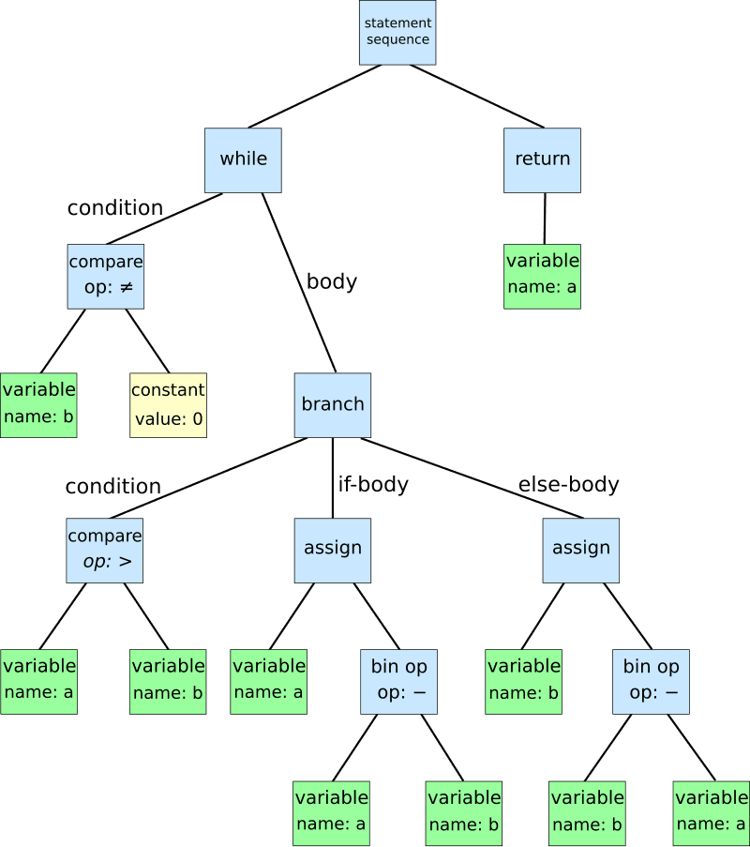
Lecture
SLIDE 5 / 14
TRC Syntax and Components
GOVERNING EQUATION
Atomic formulas include t[A] = c or t[A] = s[B] for attribute comparisons
1
The basic form is {t | t ∈ R ∧ P(t)} where R is a relation.
2
Logical connectives like AND, OR, NOT combine atomic formulas into complex conditions.
3
Quantifiers ∃ (exists) and ∀ (for all) allow expressing existence and universality.
4
Free variables in the formula determine the attributes of the resulting tuples.
5
Bound variables are local to the quantifier and do not appear in output.
Source: fiveable.me
Chandigarh University
5 / 14
Notes:
The basic form is {t | t ∈ R ∧ P(t)} where R is a relation. Atomic formulas include t[A] = c or t[A] = s[B] for attribute comparisons. Logical connectives like AND, OR, NOT combine atomic formulas into complex conditions. Quantifiers ∃ (exists) and ∀ (for all) allow expressing existence and universality.

Slide 6
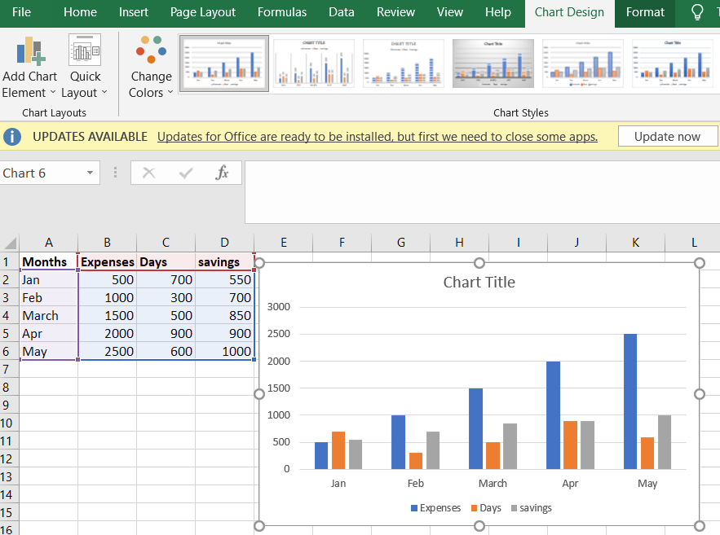
Lecture
SLIDE 6 / 14
Domain Relational Calculus Definition
1
DRC uses variables that range over domains (atomic values) rather than tuples.
2
A query is expressed as { | P(x1, x2, ..., xn)}.
3
Each variable ξ corresponds to a specific attribute in the result schema.
4
The formula P describes relationships between domain variables using predicates.
5
Variables in DRC represent column values, not entire rows of data.
6
This method is logically equivalent to Tuple Relational Calculus in power.
Source: media.geeksforgeeks.org
Chandigarh University
6 / 14
Notes:
Domain Relational Calculus uses variables that range over domains rather than tuples. A query is expressed as { | P(x1, x2, ..., xn)}. Each variable ξ corresponds to a specific attribute in the result schema. The formula P describes relationships between domain variables using predicates.

Slide 7
Lecture
SLIDE 7 / 14
DRC Syntax and Predicates
GOVERNING EQUATION
Comparisons like x1 = c or x1 = x2 check values against constants or each other
1
Atomic formulas include R(x1, x2, ..., xn) where R is a relation name.
2
Logical connectives AND, OR, NOT combine atomic formulas into complex conditions.
3
Quantifiers ∃ and ∀ bind domain variables to specific values in relations.
4
The result is a set of tuples formed by the values of free variables.
5
Variables must be explicitly bound to relation attributes within the formula.
Chandigarh University
7 / 14
Notes:
Atomic formulas include R(x1, x2, ..., xn) where R is a relation name. Comparisons like x1 = c or x1 = x2 check values against constants or each other. Logical connectives AND, OR, NOT combine atomic formulas into complex conditions. Quantifiers ∃ and ∀ bind domain variables to specific values in relations.

Slide 8
Worked Example
SLIDE 8 / 14
TRC Query
SCHEMA
Student(sid, sname, dept) and Enrolled(sid, cid).
QUERY
{t.sname | ∃s ∈ Student(t.sname = s.sname) ∧ ∃e ∈ Enrolled(s.sid = e.sid ∧ e.cid = 'CS101')}.
• Find names of students who have taken course 'CS101' using TRC.
• Variable t ranges over Student tuples, s ranges over Student, e over Enrolled.
• The formula checks if a student name matches a record with course CS101.
• Result is a set of names (strings) extracted from the Student relation.
Chandigarh University
8 / 14
Notes:
Let's find names of students who have taken course CS101 using TRC. The schema includes Student and Enrolled relations. The query uses existential quantifiers to link student names to enrollment records. Variable t ranges over Student tuples, s ranges over Student, e over Enrolled. The formula checks if a student name matches a record with course CS101.

Slide 9
Worked Example
SLIDE 9 / 14
DRC Query
SCHEMA
Student(sid, sname, dept) and Enrolled(sid, cid).
QUERY
{ | ∃sid ∃dept (Student(sid, sn, dept) ∧ ∃cid (Enrolled(sid, cid) ∧ cid = 'CS101'))}.
• Find names of students who have taken course 'CS101' using DRC.
• Variables sid, sn, dept range over Student attributes; cid ranges over Enrolled.
• The formula binds sid to a student and checks for the specific course ID.
• Result is a set of strings (sn) extracted from the Student relation.
Chandigarh University
9 / 14
Notes:
Now let's find names of students who have taken course CS101 using DRC. The schema includes Student and Enrolled relations. The query uses existential quantifiers to link student names to enrollment records. Variables sid, sn, dept range over Student attributes; cid ranges over Enrolled. The formula binds sid to a student and checks for the specific course ID.

Slide 10
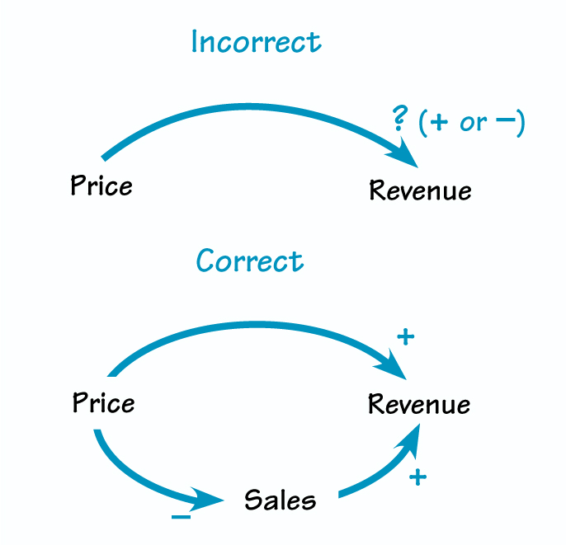
Lecture
SLIDE 10 / 14
Safety Conditions in Calculus
1
An unsafe query can produce an infinite set of results or undefined behavior.
2
A formula is safe if every value in the result appears in the database.
3
Safety requires that all variables in the formula are bound to finite domains.
4
Unbound variables in quantifiers can lead to infinite sets of possible values.
5
Database systems must check safety before executing a calculus query expression.
6
Unsafe queries are rejected by the DBMS to prevent system crashes.
Source: thesystemsthinker.com
Chandigarh University
10 / 14
Notes:
An unsafe query can produce an infinite set of results or undefined behavior. A formula is safe if every value in the result appears in the database. Safety requires that all variables in the formula are bound to finite domains. Unbound variables in quantifiers can lead to infinite sets of possible values.

Slide 11
Common Pitfalls
SLIDE 11 / 14
Unbound Variables
1
Writing {t | t ∈ R} without a condition creates an infinite set of tuples.
2
Using a variable in the result that is not bound by a quantifier.
3
Assuming a variable exists in a relation without checking the relation name.
4
Neglecting to specify the domain for a variable in Domain Relational Calculus.
5
Failing to check if the result set is finite before execution.
6
Confusing free variables with bound variables in complex logical expressions.
Chandigarh University
11 / 14
Notes:
Writing {t | t ∈ R} without a condition creates an infinite set of tuples. Using a variable in the result that is not bound by a quantifier is a common error. Assuming a variable exists in a relation without checking the relation name is dangerous. Neglecting to specify the domain for a variable in Domain Relational Calculus leads to ambiguity.

Slide 12
Lecture
SLIDE 12 / 14
Equivalence with Relational Algebra
1
Tuple and Domain Relational Calculus are equivalent in expressive power to Relational Algebra.
2
Any query expressible in calculus can be rewritten using Relational Algebra operators.
3
Converting calculus to algebra involves translating quantifiers into selection and join.
4
This equivalence proves that both formalisms define the same set of queries.
5
The DBMS optimizer translates calculus queries into algebraic execution plans.
6
Understanding this link is crucial for query optimization and performance tuning.
Chandigarh University
12 / 14
Notes:
Tuple and Domain Relational Calculus are equivalent in expressive power to Relational Algebra. Any query expressible in calculus can be rewritten using Relational Algebra operators. Converting calculus to algebra involves translating quantifiers into selection and join. This equivalence proves that both formalisms define the same set of queries.

Slide 13
Lecture
SLIDE 13 / 14
Key Takeaways
1
TRC variables range over tuples while DRC variables range over domain values.
2
Both languages are non-procedural and define what data to retrieve.
3
Safety conditions are mandatory to ensure finite and well-defined result sets.
4
Quantifiers ∃ and ∀ are essential for expressing complex logical conditions.
5
Calculus is logically equivalent to Relational Algebra in query power.
Chandigarh University
13 / 14
Notes:
TRC variables range over tuples while DRC variables range over domain values. Both languages are non-procedural and define what data to retrieve. Safety conditions are mandatory to ensure finite and well-defined result sets. Quantifiers ∃ and ∀ are essential for expressing complex logical conditions.

Slide 14
Lecture
SLIDE 14 / 14
References
1
Fundamentals of Database Systems — Ramez Elmasri & Shamkant B. Navathe
2
Database System Concepts — Silberschatz, Korth & Sudarshan
3
Database Management Systems — Raghu Ramakrishnan & Johannes Gehrke
4
Oracle/MySQL Documentation — Oracle
Chandigarh University
14 / 14
Notes:
For further reading, please refer to the standard texts by Elmasri and Navathe, or Silberschatz. The book by Ramakrishnan provides excellent coverage of formal query languages. Finally, consult the Oracle and MySQL documentation for practical implementation details. Thank you for your attention today.

